Slide 1
NE 795: Advanced Reactor Materials
Fall 2023
Dr. Benjamin Beeler

Slide 2
Last Time
Rapid walkthrough of FeCrAl and ODS steels
FeCrAl: fully ferritic; good mechanical properties and void swelling resistance; includes additional Al to improve high temperature steam corrosion; hardening and reduction in ductility saturates with irradiation; alpha’ precipitation leads to embrittlement
ODS: Y2O3 or Y2Ti2O7 particles dispersed in steels, often F/M steels; oxide particles help to stabilize ferrite; excellent resistance to swelling; excellent creep resistance; minimal hardening; difficult to fabricate or shape
Started Ni alloys

Slide 3
Ni alloys

Slide 4
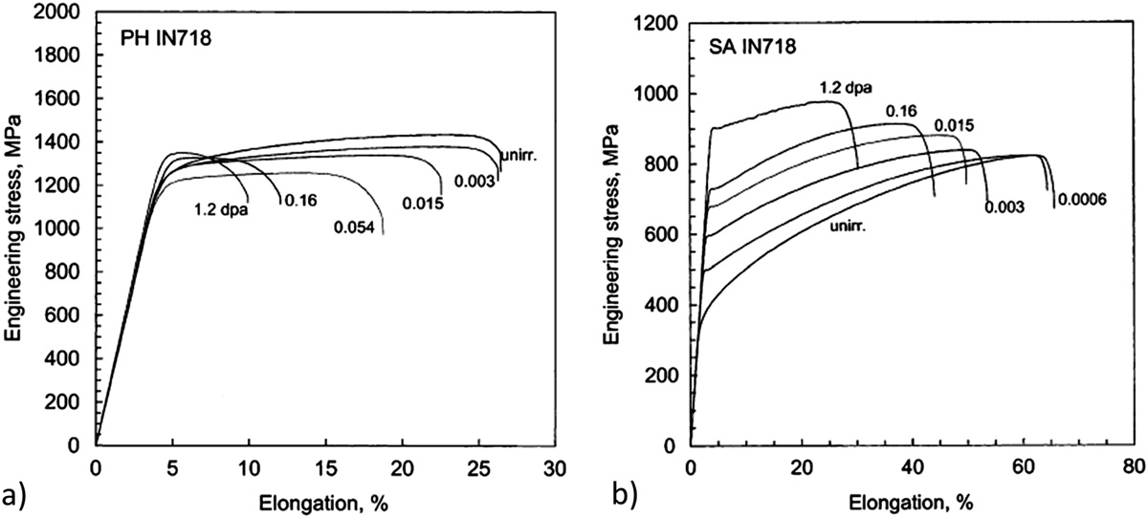
Irradiation Hardening
Ni alloys can generally be categorized into two classes: solution-annealed (SA) or precipitation hardened (PH)
The irradiation response is very different in these two classes
PH materials irradiated at low temperatures (below 100C) and low doses exhibit reduced ductility, but minimal hardening
SA materials exhibit substantial hardening in addition to a reduction in ductility

Slide 5
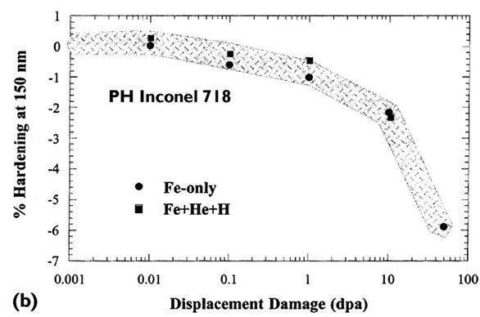
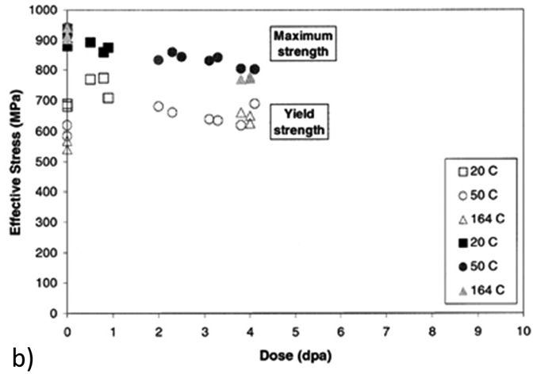
Higher Doses
For PH materials, after an initial increase in RT yield and UTS at low doses, further irradiation can result in a gradual decrease in strength
This has also been seen in PH-SS at elevated temperatures
This does not occur for SA Ni alloys
Softening due to dislocation recovery is likely the effect at high temperatures
At low T, this is likely due to precipitate dissolution

Slide 6
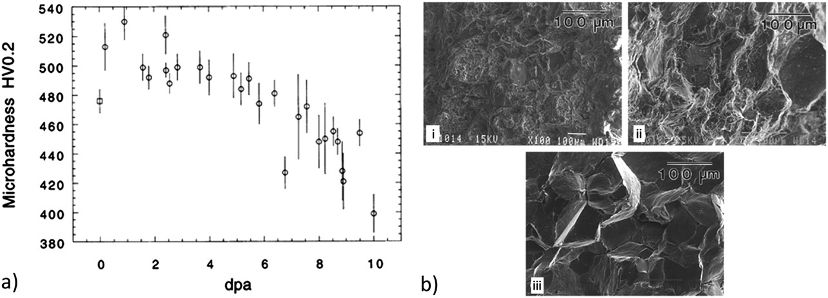
Embrittlement
Despite softening, ductility continues to decrease, embrittling the PH Ni alloy
There is a change from ductile intra-granular to brittle inter-granular failure with increasing dose at low T
This is likely related to He generation, stabilization of He grain boundary bubbles, and embrittlement
Thus, separate phenomena are leading to softening and embrittlement simultaneously
This knowledge base is built on ion irradiations, and some effects may not fully transfer to fast reactor systems

Slide 7
Ni Alloys Summary
Excellent high temperature behaviors, resistant to corrosion, reasonably compatible with molten salt, water, liquid Na
Ni transmutation is an issue which generates He, which can lead to embrittlement (bigger issue in thermal reactors)
Ni alloys are at least 28 wt% Ni, have an FCC phase, are either solid solution strengthened, or precipitation hardened (mostly PH)
gamma’ and gamma’’ precipitates provide strength, hardening, and swelling resistance
Alloys can soften with increased dose due to recovery of cold work at high T, but lose their ductility with increasing dose
Don’t have enough good data on irradiation effects in fast reactor enrivonments

